Slide 1
Oracle Integration Cloud an Introduction
By Senthil Raman

Slide 2
Oracle Integration Cloud
Connects and integrates various applications like SaasS with on premise application
Preintegrated with applications—Eliminate the slow, error-prone process of configuring and manually updating web service and other styles of application integration.
Best practice integration flows—Take the guesswork out of integration with machine learning recommendations between applications spanning CX, ERP, HCM, and other applications.
Connects your applications, on-premise with Cloud (Integration Cloud Service) and helps in design, monitor, and manage connections between your applications
Automate & Manage business Process (Process Cloud Service)
Build Applications Visually (Visual Builder Cloud Service)

Slide 3
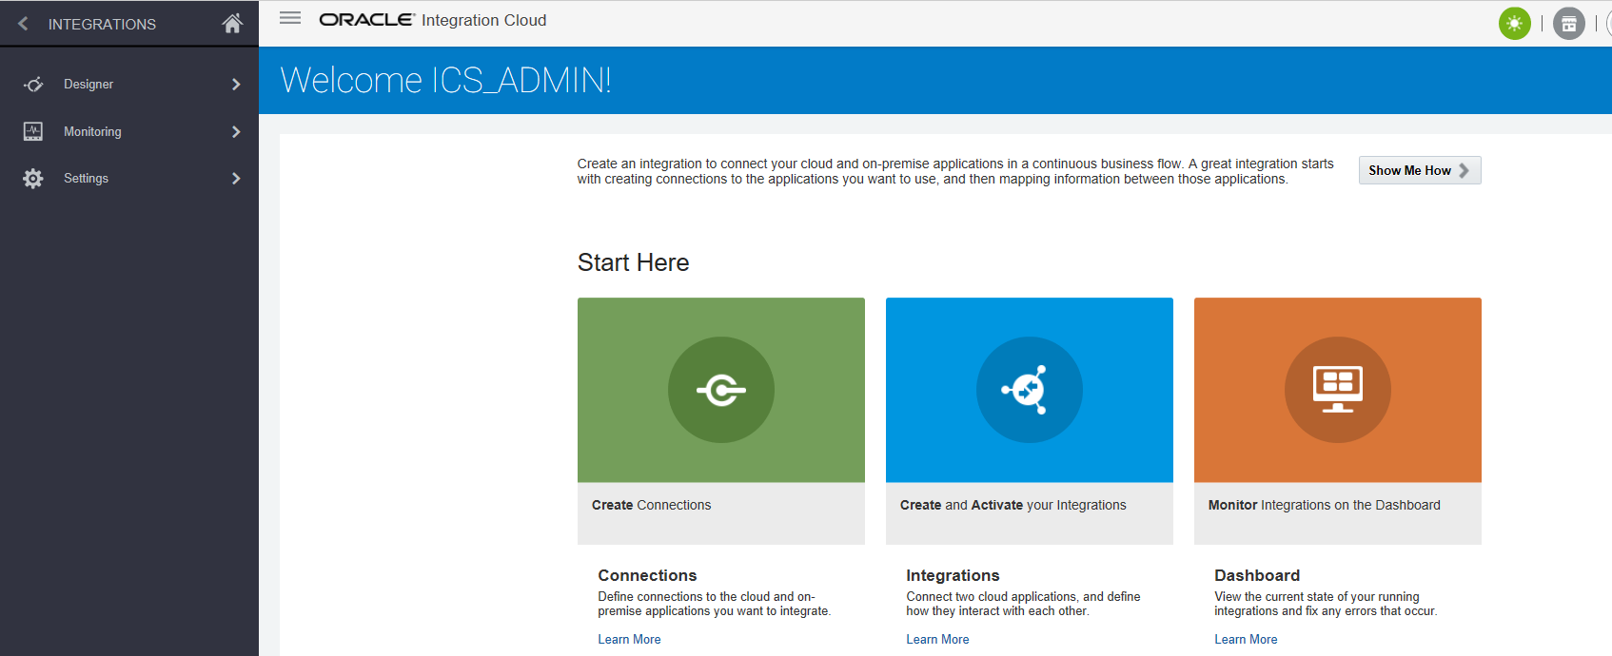
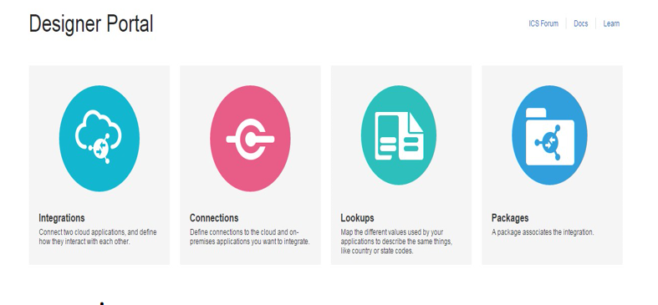
Designer

Slide 4
Integrations
Developing Integration between SaaS application is done through ICS via web based tool
Message Transformation
Loookup
Libraries
Packages
Assign

Slide 5
Connections
A connection is defined for any endpoint (source or target) that is implemented within an integration. These connections are based off of defined adapters. Adapters allow for easy connectivity to applications, insulating the developer from complexities that can occur when interacting with an application
Set of pre defined Adapters

Slide 6
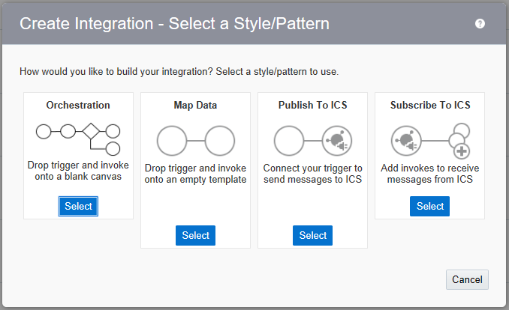
Create Integration

Slide 7
Agents
The cloud agents monitor and collect data (for example, metrics, configuration information, and logs) from entities that reside on hosts, or on virtual hosts in a cloud.
Connect on-Premise Applications
Create/Download/Install Agents

Slide 8
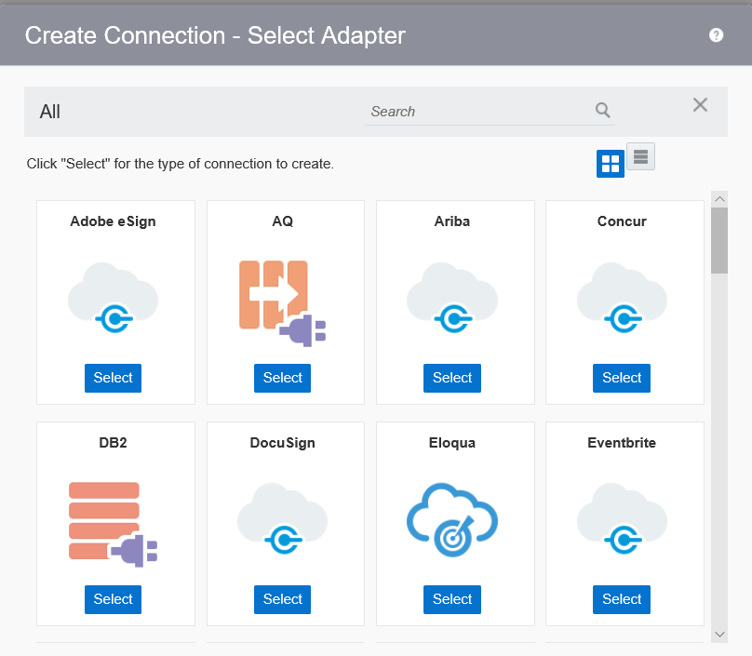
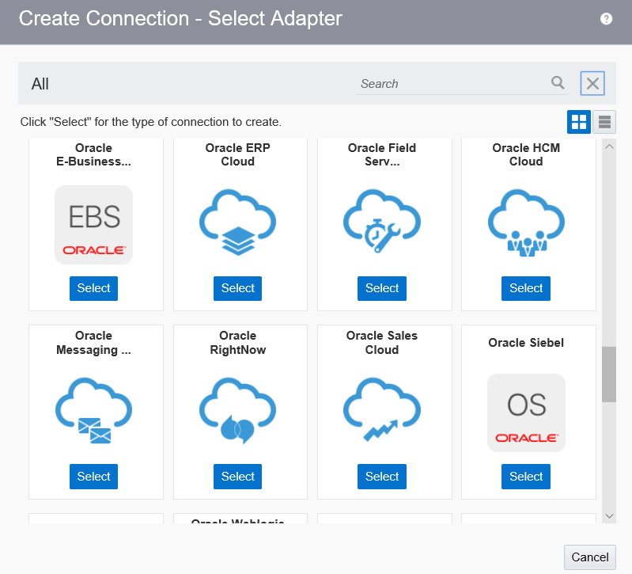

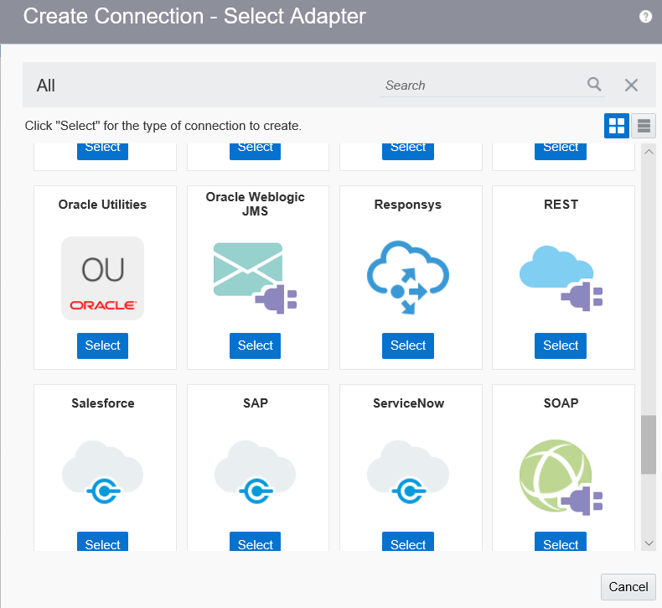

Adapter

Slide 9
END
Find out more at the PowerPoint Getting Started Center
(Click the arrow when in Slide Show mode)
Notes:
In Slide Show mode, click the arrow to enter the PowerPoint Getting Started Center.

